Slide 1



Executive Overview
Products in Scope:
Grünenthal Pharma GmbH & Co. KG
Sourcing+
Procurement
Supplier Management+
What’s working:
Improvement Opportunities:
Requisition to PO approval times are efficient
Overall adoption is average
Events are being awarded in the system
Utilize RFx templates or creation from existing events to gain significant time savings, consistency and compliance.
Competitive procurement process & a good supplier engagement​
Look for ways to award more sourcing events to facilitate automation and compliance
Enrich Supplier 360 with additional information (e.g. 3rd party data)
Opportunity to increase on-contract spend

Slide 2
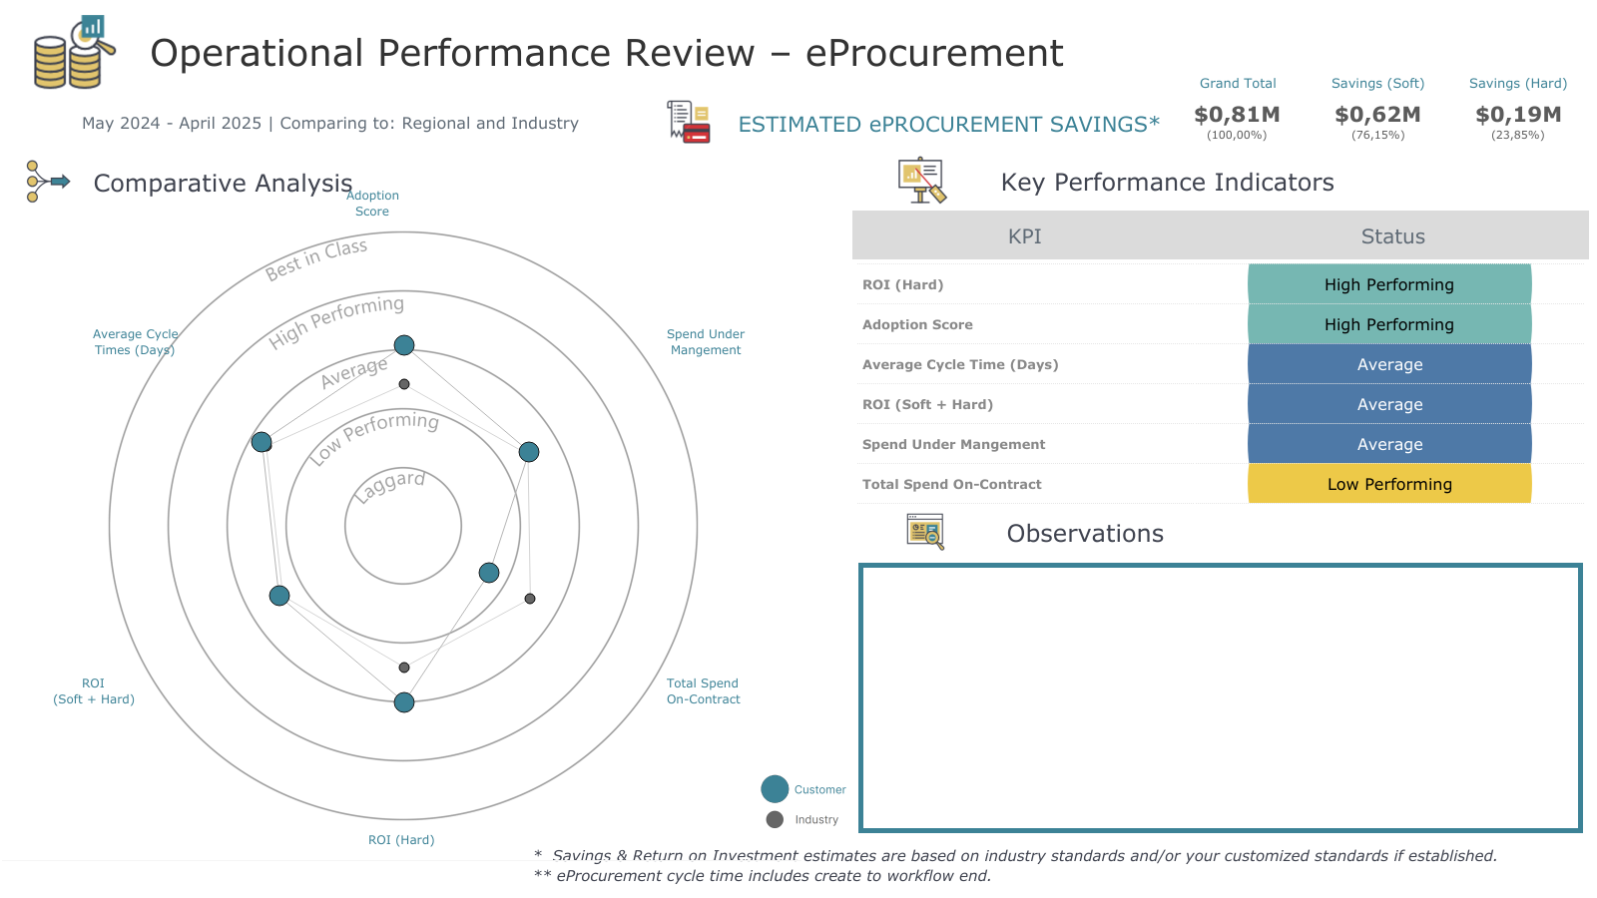
1.7 days average cycle time is average
18.6k PO count is less (-64%) than industry average in same region (52k)
2.2 % total spend on-contract should improve. Industry average in same region 7%
Notes:
ePro % $ On Contract: -Total Contract Spend % based on Total $. Includes Catalog Spend, Non-Catalog Contract Spend, Sourcing Spend, and Non-PO Inv Contract Spend Divided by Total ePro Spend + Non-PO Inv Spend

Slide 3
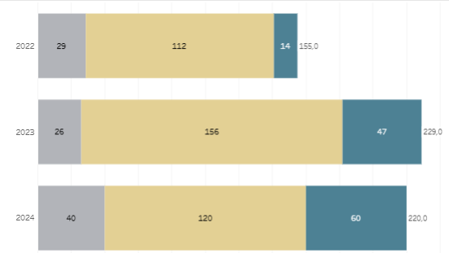
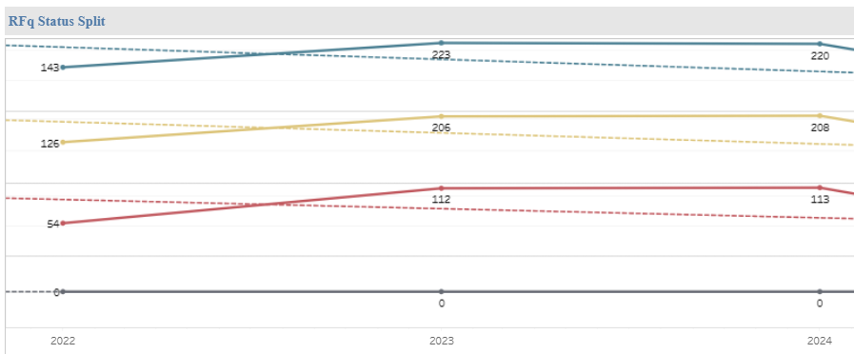
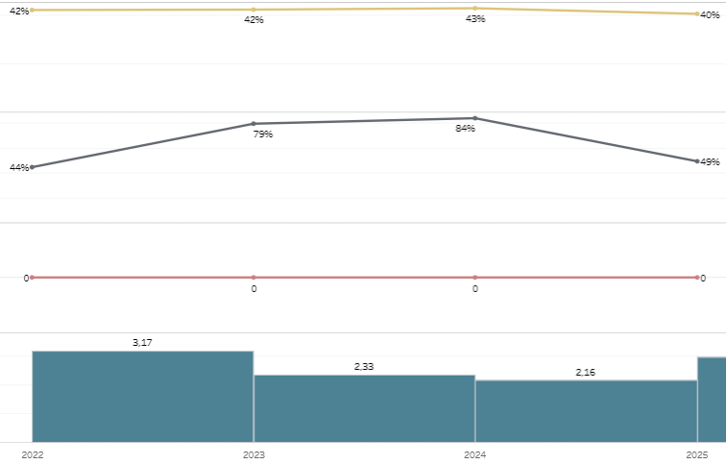
Solution Assessment - Sourcing+
January 2022 – December 2024
How are users creating RFX?
+37% of events created from template or RFx
between 2023 & 2024
Focus on Request for Quotation
Observations
In average ~ 42% events with only one supplier
In average 2-3 invited suppliers per event
Standard participations rate: 68% supplier bidders
Number of awarded events in the system ~50%
Invited vs Bidders

Slide 4
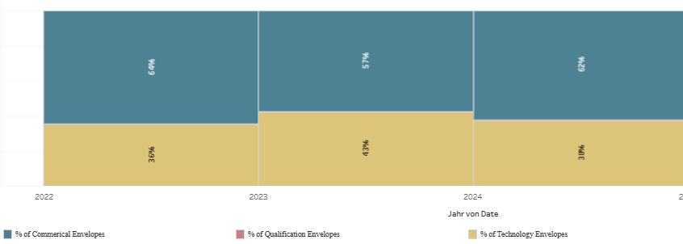
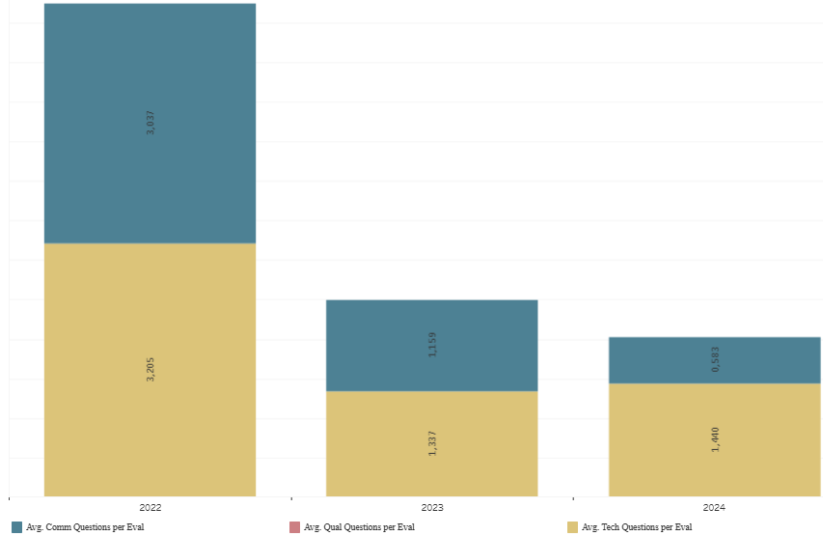
Solution Assessment - Sourcing+
January 2022 – December 2024
Envelope Types by Percentage
Observations
Number of questions per envelope very low
Envelope Questions Avg

Slide 5
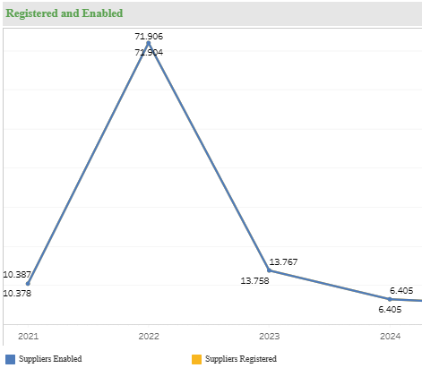
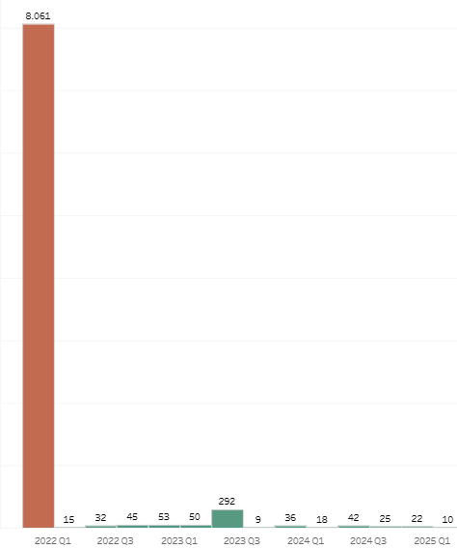
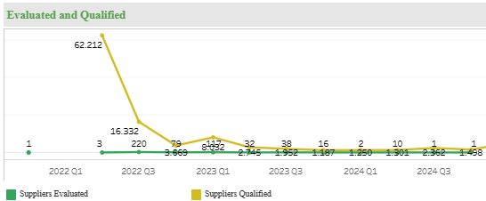
Solution Assessment – Supplier Management+
January 2021 – June 2023
Suppliers with at least 1 category
Observations
113k active suppliers
Number of qualified and classified suppliers low

Slide 6
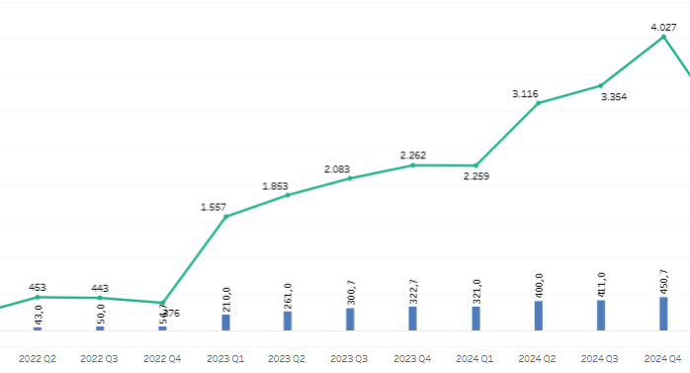
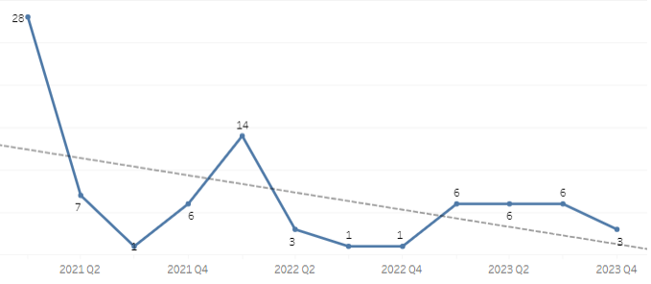
Solution Assessment – Users
January 2021 – January 2024
Active users
Number of logins and unique user logins
1.719
Registered users trend
Observations
Unique user logins have trended upwards since 2022

